Slide 1


{{PROPERTY_TYPE}} FOR LEASE
{{PROPERTY_NAME}}
{{PROPERTY_ADDRESS}}
PRIME PHILIPPINES 2026

Slide 2






ECONOMIC HIGHLIGHTS IN {{PROPERTY_LOCATION}}

Slide 3
PROPERTY LOCATION & VICINITY MAP
{{LOCATION_MAP}}

Slide 4

VICINITY OVERVIEW
{{VICINITY_MAP}}

Slide 5
{{PROPERTY_LOCATION}} {{PROPERTY_TYPE}}
Trade Area Landscape
PRIME PHILIPPINES 2026

Slide 6
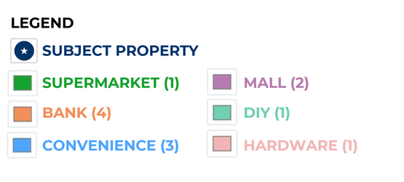
TRADE AREA OVERVIEW

Slide 7



PROPERTY PHOTOS
{{PROPERTY_LOCATION}}
{{PROPERTY_PHOTO_1}}
{{PROPERTY_PHOTO_3}}
{{PROPERTY_PHOTO_2}}
{{PROPERTY_PHOTO_4}}

Slide 8
PROPERTY HIGHLIGHTS

Slide 9
LOT PLAN
{{PROPERTY_LOCATION}}
{{LOT_PLAN}}

Slide 10
FLOOR PLAN
{{PROPERTY_LOCATION}}
{{FLOOR_PLAN}}

Slide 11
{{PROPERTY_NAME}} {{LEASABLE_AREA}}
{{PROPERTY_ADDRESS}}
{{PROPERTY_PHOTO_1}}
Key Features
Lease Terms & Conditions | Lease Terms & Conditions
Rental Rates | {{RENTAL_RATES}}
Security Deposit | {{SECURITY_DEPOSIT}}
Advance Rent | {{ADVANCE_RENT}}
Escalation Rate | {{ESCALATION_RATE}}
Preffered Lease Term | {{LEASE_TERM}}

Slide 12


For more information and to schedule a viewing contact us at:
SONDI TUAZON
Sr. Head – Retail and Industrial Markets
(+63) 917 843 6128
sondi.tuazon@primephilippines.com
sondi.primecorp@gmail.com
IRISH JANE RIMA
Markets Analyst
(+63) 968 135 1848
irish.rima@primephilippines.com
OFFICE LOCATIONS
Manila
32/F SM Megatower, EDSA, corner Doña Julia Vargas Ave, Mandaluyong City Metro Manila
Cebu
Fifth Floor, Park Centrale, Cebu I.T. Park Jose Maria del Mar Street, Cebu City 6000
Davao
Fourth Floor, Topaz Tower,Damosa I.T. Park, J.P. Laurel Avenue, Lanang, Davao City 8000

Slide 13
PRIME PHILIPPINES • EST. 2013
Real Estate. We Advise. You Advance.
MANILA • CEBU • DAVAO

